Slide 1

Automotive Technology: A Systems Approach, 8e
Chapter 30: Electronic Fuel Injection
Rob Thompson and Jack Erjavec, Automotive Technology: A Systems Approach, 8th Edition. © 2025 Cengage. All Rights Reserved. May not be scanned, copied or duplicated, or posted to a publicly accessible website, in whole or in part.

Slide 2
Chapter Objectives
30.01 Describe the difference between different types of fuel injection systems.
30.02 Explain the design and function of major EFI components.
30.03 Describe the operation of the pressure regulator in a returnless EFI system.
30.04 Describe the operation of direct gasoline injection systems.
30.05 Describe the operation of the injection systems used in light- and medium-duty diesel engines.

Slide 3
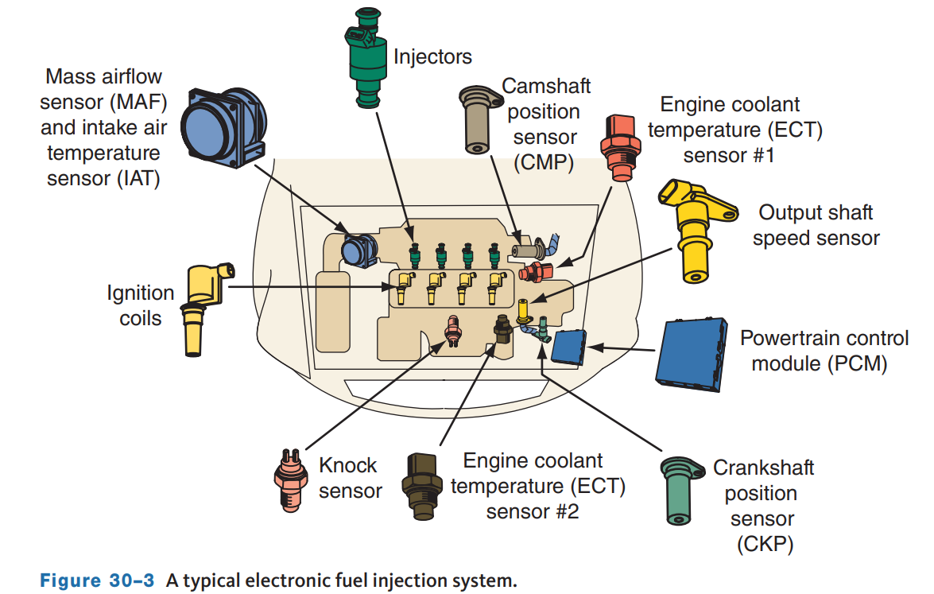
Basic EFI
30.02 Explain the design and function of major EFI components.
In an EFI system, the computer must know the amount of air entering the engine so it can supply the correct amount of fuel for that amount of air.
In systems with a manifold absolute pressure (MAP) sensor, the computer calculates the amount of intake air based on MAP and rpm input signals.
This type of EFI system is referred to as a speed density system, because the computer calculates the air intake flow according to engine speed and intake manifold vacuum.

Slide 4
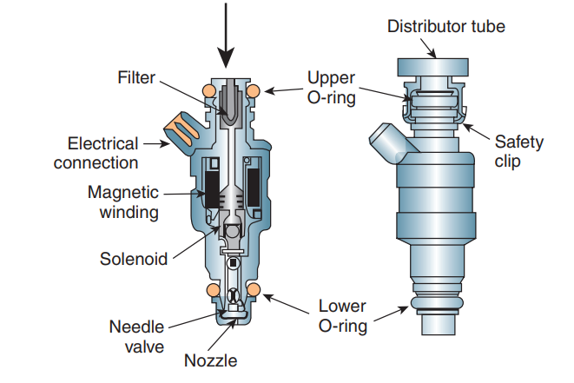
Fuel Injectors
30.01 Describe the difference between different types of fuel injection systems.
Fuel injectors are electromechanical devices that meter and atomize fuel so it can be sprayed into the intake manifold.
Injectors used on gasoline direct injection systems are bolted to the cylinder head with the fuel rail and spray fuel directly into the combustion chamber.
O-rings seal the injector at the intake manifold, throttle body, and/or fuel rail mounting positions.
These O-rings provide thermal insulation to prevent the formation of vapor bubbles and promote good hot start characteristics.

Slide 5
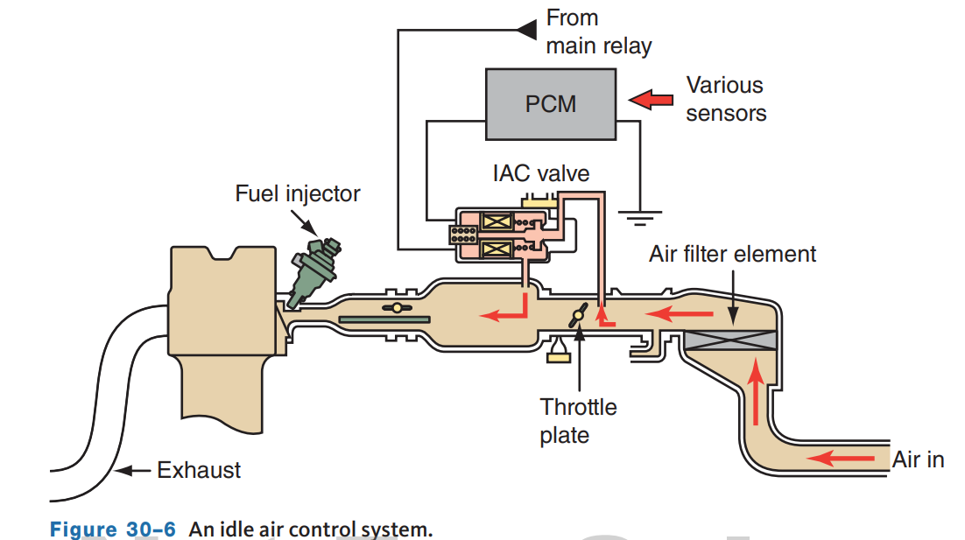
Idle Speed Control
Idle speed control is a function of the PCM. Based on operating conditions and inputs from various sensors, the PCM regulates the idle speed.
In throttle body and port EFI systems, engine idle speed is controlled by bypassing a certain amount of airflow past the throttle valve in the throttle body housing.
Two types of air by-pass systems are used: auxiliary air valves and idle air control (IAC) valves.
IAC valve systems are more common.
Engines that use electronic throttle control do not use an IAC valve.
  The PCM commands the throttle plates open a small amount, to allow airflow into the engine.

Slide 6
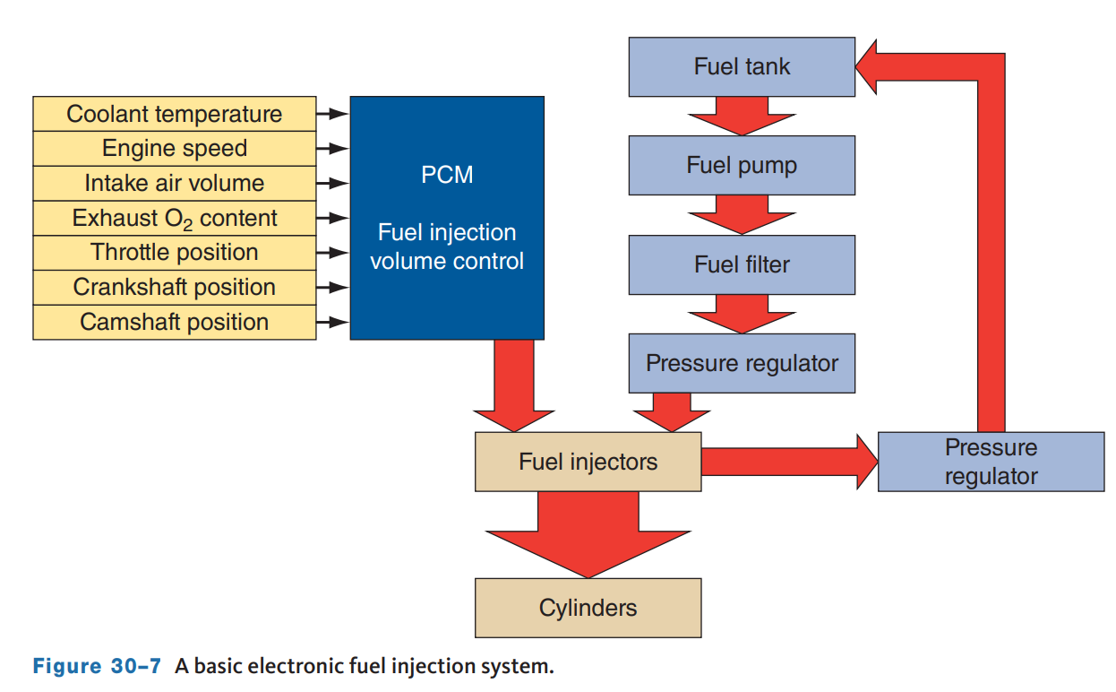
Inputs
The ability of the fuel injection system to control the air–fuel ratio depends on its ability to properly time the injector pulses with the compression stroke of each cylinder and its ability to vary the injector “on” time, according to changing engine demands.
Both tasks require the use of sensors that monitor the operating conditions of the engine.
The PCM receives these signals from the CAN bus and inputs sent directly to the computer.
Here are a few typical inputs:
  MAF sensors, MAP sensors, air–fuel ratio or oxygen sensors.

Slide 7
Knowledge Check (1 of 2)
List three typical inputs to the EFI system.

Slide 8
Knowledge Check Answer (1 of 2)
  Answer: MAF sensors, MAP sensors, air–fuel ratio, or oxygen sensors.

Slide 9
Operational Modes
All fuel injection systems operate in response to inputs.
However, the PCM’s programming allows it to define the conditions and establish a summary of those conditions.
The PCM then controls the delivery of fuel according to that mode of operation.
Different EFI systems have different operational modes, but most have starting, run, clear flood, acceleration, and deceleration.

Slide 10
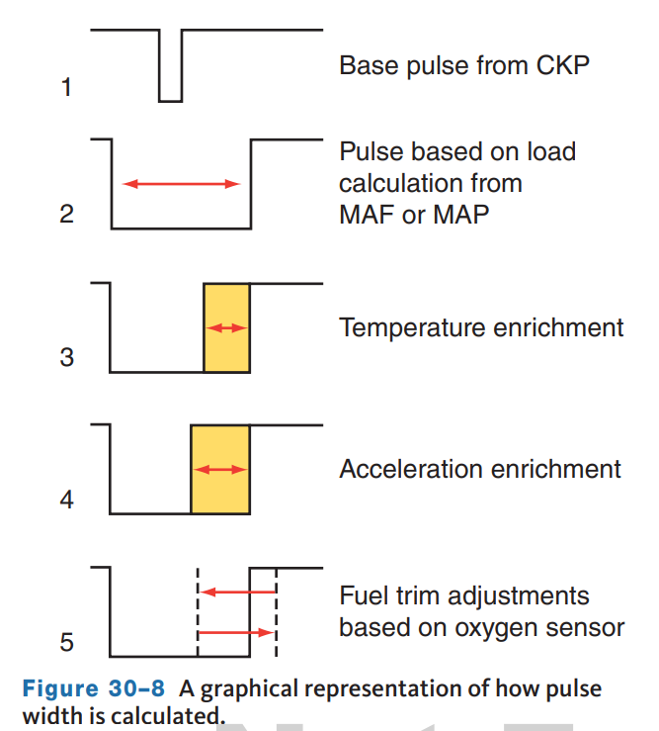
Run Mode
Once the engine has started and is running above a predetermined speed, the system will operate in open loop. In open loop, the PCM sets injector pulse width according to MAP or MAF, IAT, ECT, and TP sensor signals.
The system stays in open loop until the PCM receives good signals from the HO₂S, and a predetermined engine temperature has been reached.
Once these conditions have been met, the system moves into closed loop.
In closed loop, the PCM adjusts the pulse width according to inputs from a variety of sensors, but primarily the HO₂S or A/F ratio sensors.

Slide 11
Acceleration Mode
Based on signals from the TP and MAP or MAF sensors, the PCM can tell when the vehicle is being accelerated.
To compensate for the sudden rush of intake air as the throttle is opened, the PCM increases the injectors’ pulse width.
The pulse width change is calculated by the PCM according to inputs from the CKP, MAP, ECT, MAF, and TP sensors.
Once the PCM determines that the vehicle is no longer accelerating, the EFI system is returned to the run mode.

Slide 12
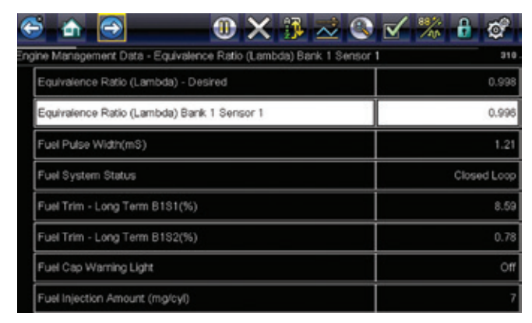
Fuel Trim
The adjustment made to the base (programmed) pulse width for operating conditions is called fuel trim.
Fuel trim can be monitored for diagnostic purposes and may be displayed as lambda.
The base pulse width is given a value of 0 percent and all changes are expressed as a negative or positive value.
A positive fuel trim value means the PCM detects a lean mixture and is increasing the pulse width to add more fuel to the mixture.
A negative fuel trim value means the PCM is reducing the amount of fuel by decreasing the pulse width to compensate for a rich condition.

Slide 13
Throttle Body Injection (TBI)
For many auto manufacturers, TBI served as a stepping stone from carburetors to more advanced fuel injection systems.
TBI units were used on many engines during the 1980s and 1990s.
The throttle body unit is mounted directly to the intake manifold.
The injector(s) spray fuel down into a throttle body chamber leading to the intake manifold.
The intake manifold feeds the air–fuel mixture to all cylinders.
Four-cylinder engines have a single throttle body assembly with one injector and throttle plate, whereas V6 and V8 engines are usually equipped with dual injectors and two throttle plates on a common throttle shaft.
Throttle body systems are not as efficient as port injection systems.
Fuel is not distributed equally to all cylinders, the air and fuel from the TBI unit pass through the intake manifold, and the length and shape of the manifold’s runners affect distribution.

Slide 14
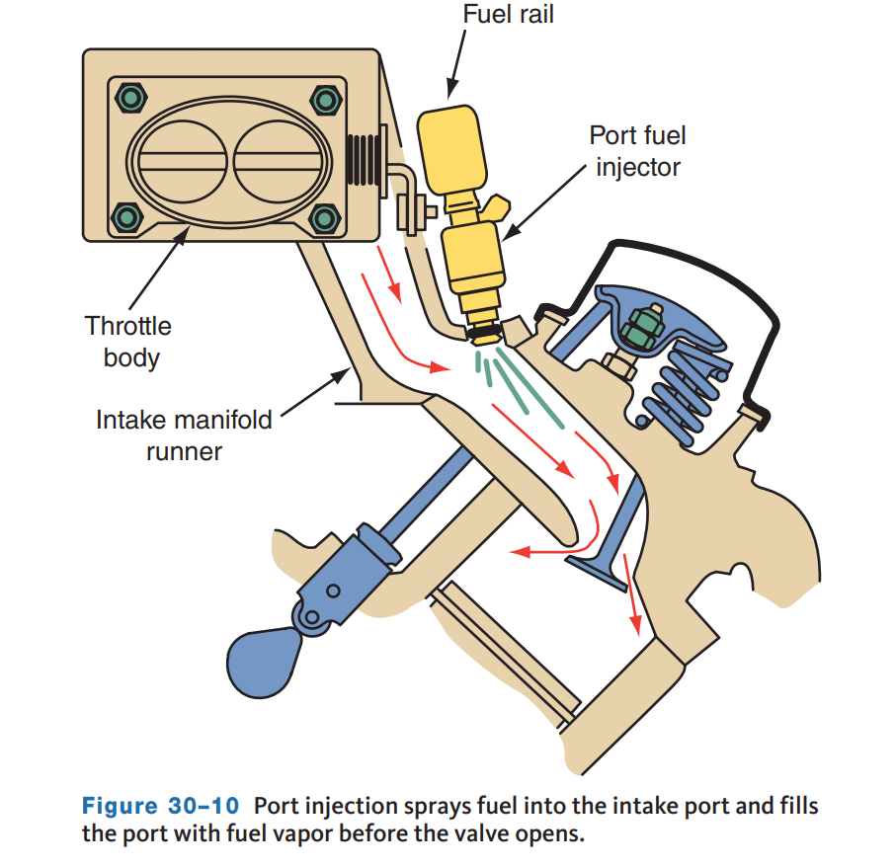
Port Fuel Injection (PFI)
PFI systems use at least one injector at each cylinder.
They are mounted in the intake manifold near the cylinder head where they can inject a fine, atomized fuel mist as close as possible to the back of the intake valve.
Delivering the fuel mist right outside the combustion chamber allows the fuel to break down and vaporize a little more before it enters the cylinder.
PFI systems can be divided into two basic categories: multiport injection (MPI) systems and sequential fuel injection (SFI) systems; each is defined by injector control.

Slide 15
MPI Systems
Due to OBD II regulations, MPI systems are no longer used.
In MPI systems, the injectors were grouped together and the injectors in each group or bank fired at the same time.
Some MPI systems fired all of the injectors simultaneously.
The injectors were connected in parallel so they shared one driver circuit and the PCM sent out one signal for all injectors.
The amount of fuel required for each four-stroke cycle was divided in half and delivered in two injections, one for every 360 degrees of crankshaft rotation.
The fact that the intake charge had to wait in the manifold for varying periods was the system’s major drawback.
In grouped systems, there is a power and ground circuit for each group.
When the injectors are split into two equal groups, the groups are fired alternatively, with one group firing each engine revolution.

Slide 16
Sequential Fuel Injection
SFI systems require a camshaft position sensor to determine when to fire the injectors in addition to a MAF or MAP sensor and other sensors.
These systems control each injector separately so that it fires just before the intake valve opens.
This means that the mixture is never static in the intake manifold, and adjustments to the mixture can be made instantaneously between the firing of one injector and the next.
Sequential firing is the most accurate and desirable method of regulating port injection.
To meet OBD II regulations, SFI systems are capable of turning off the injector at a misfiring cylinder.
This also allows manufacturers to use cylinder deactivation technology to improve fuel economy under steady cruise and light load conditions.
In SFI systems, each injector is connected individually to the computer, and the computer completes the ground for each injector one at a time.

Slide 17
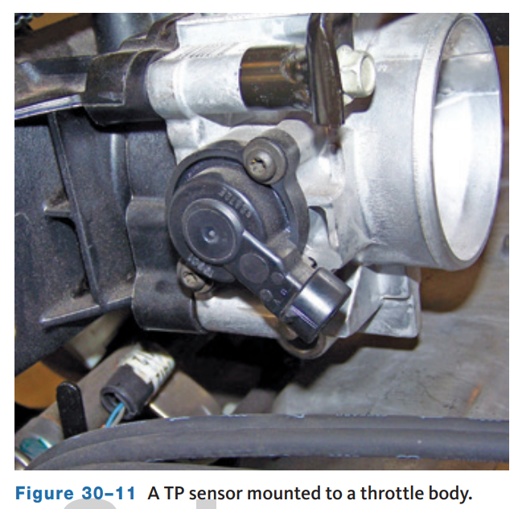
Throttle Body
The throttle body in a PFI system controls the amount of air that enters the engine as well as the amount of vacuum in the intake manifold. On non-electronic throttle control systems, the throttle body assembly is comprised of an IAC valve assembly, an idle air orifice, single or double bores with throttle plates, and a TP sensor.
The throttle body housing assembly is a single-piece aluminum or plastic casting.
The throttle bore and throttle plates control the amount of intake air that enters the engine.
The throttle shaft and plate(s) are controlled by the accelerator pedal, via a linkage comprised of a cam and cable.

Slide 18
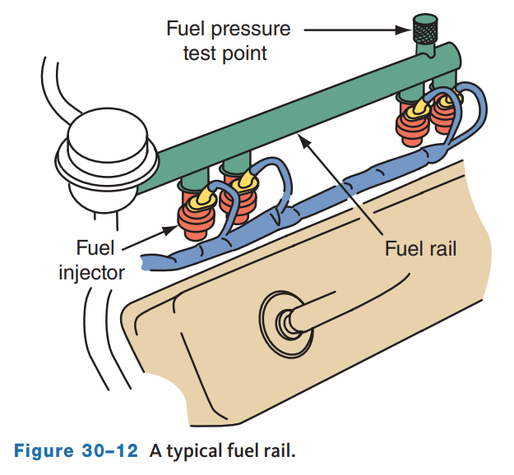
Fuel Delivery
The fuel injectors are separately controlled and are mounted to the intake manifold and supply pressurized fuel through fuel lines.
These fuel lines run to each cylinder from a fuel manifold, usually referred to as a fuel rail.
The fuel rail also has a fuel pressure test port, and on returnless fuel systems, a fuel rail pressure (FRP) sensor.
The rail is supplied fuel by the fuel pump and distributes the same amount of fuel at the same pressure to each cylinder.
Because the fuel is dispensed at each cylinder and not the intake manifold, there is little or no fuel to wet the manifold walls; therefore, there is no need for manifold heat or early fuel evaporation system.

Slide 19
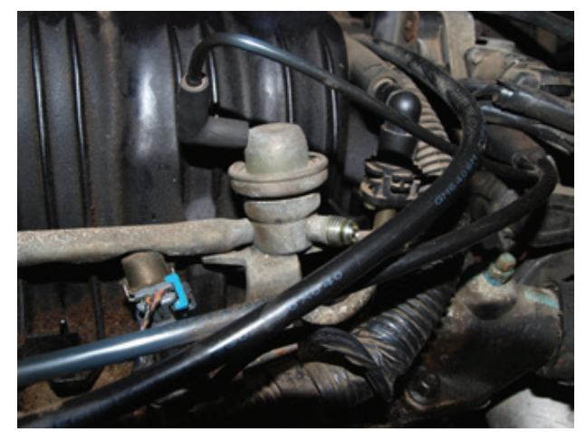
Pressure Regulators
30.03 Describe the operation of the pressure regulator in a returnless EFI system.
PFI systems require an additional control not required by TBI units.
In a TBI, the injectors are mounted above the throttle plates and are not affected by fluctuations in manifold vacuum; port injectors have their tips located in the manifold where constant changes in vacuum would affect the amount of fuel injected.
To compensate for these fluctuations, port injection systems have a fuel pressure regulator that senses manifold vacuum and continually adjusts the fuel pressure to maintain a constant pressure drop across the injector.
The pressure regulators respond to changes in manifold pressure due to engine load.

Slide 20
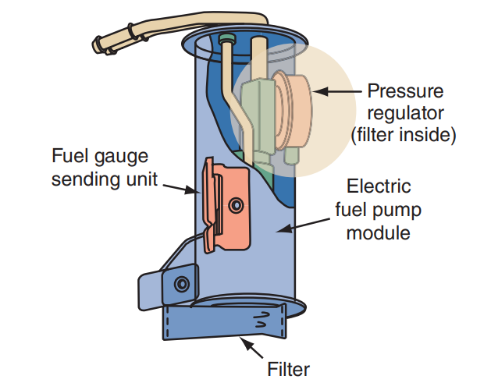
Returnless Systems
Nearly all late-model injection systems are returnless systems.
Those systems that have a fuel pressure regulator as part of the fuel sender and pump assembly in the fuel tank and are called mechanical returnless systems.
The term is applied because the regulator sits inside the fuel tank, and there is no designated return fuel line, and its action is not related to engine vacuum.
With a returnless system, only the fuel needed by the engine is filtered, thus allowing the use of a smaller fuel filter.

Slide 21
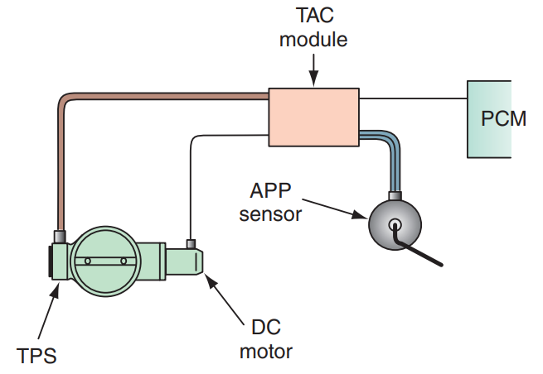
Throttle-by-Wire Systems
Throttle-by-wire systems eliminate the need for a throttle cable and linkage.
They also provide many other benefits over traditional throttle controls, such as improved driveability, increased fuel efficiency, and decreased emissions.
Throttle-by-wire systems are used by all manufacturers; each calls their system by a different name, the most common being electronic throttle body (ETB) and electronic throttle control (ETC).
There are differences in the programming and hardware used.
Based on inputs from accelerator pedal sensors and its programming, the PCM electronically controls the position of the throttle plate.

Slide 22
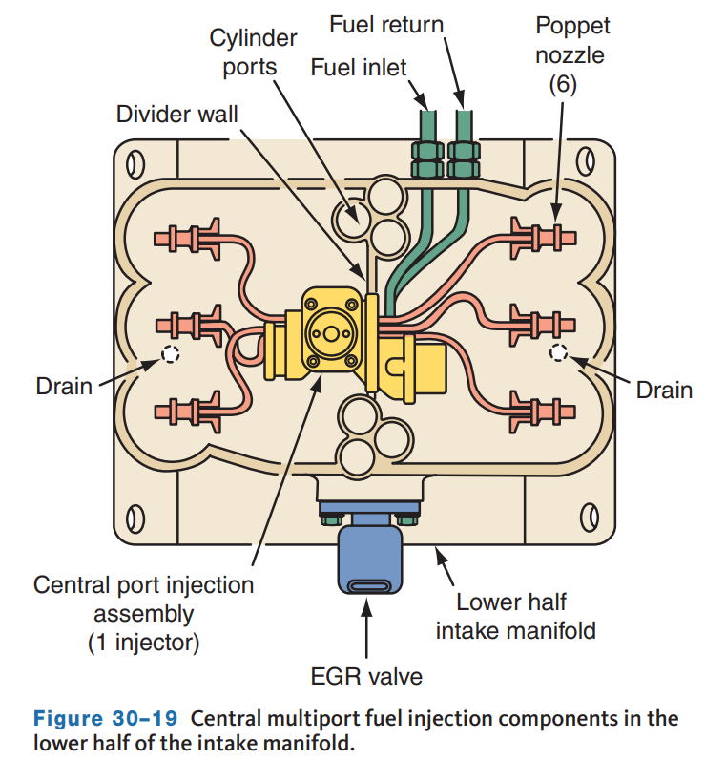
Central Port Injection (CPI) (1 of 2)
Found on certain older General Motor’s V6 and V8 engines, central port injection (CPI) or central multiport injection (CMFI) systems have a central injector assembly mounted in the lower half of the intake manifold.
The CPI system uses one injector to control the fuel flow to individual poppet nozzles.
The CPI injector assembly consists of a fuel metering body, a pressure regulator, one fuel injector, poppet nozzles with nylon fuel tubes, and a gasket seal.
The injector distributes metered fuel through the lines connected to the nozzles.

Slide 23
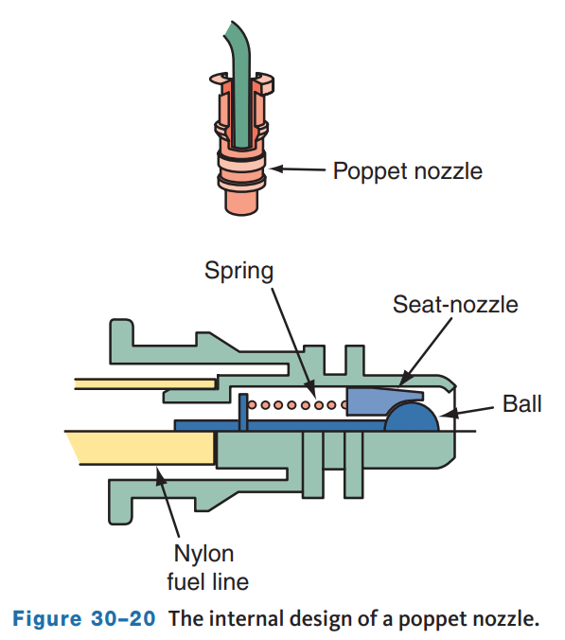
Central Port Injection (CPI) (2 of 2)
Poppet Nozzles
  The poppet nozzles are snapped into openings in the lower half of the intake manifold, and the tip of each nozzle directs fuel into an individual intake port.
  Each poppet nozzle contains a check ball and seat at the tip of the nozzle.
  A spring holds the check ball in the closed position.
  When fuel pressure is applied to the nozzles, the pressure forces the check ball to open against spring pressure.

Slide 24
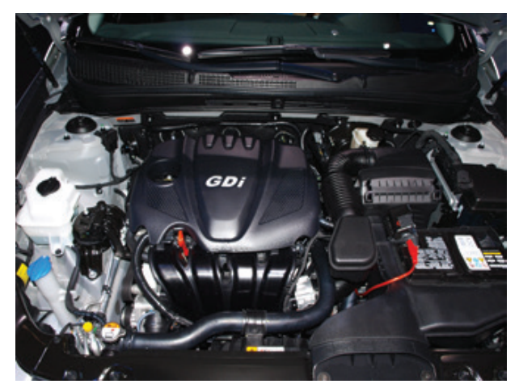
Gasoline Direct-Injection Systems
30.04 Describe the operation of direct gasoline injection systems.
With direct injection, highly pressurized fuel is sprayed directly into the cylinders.
This type of injection is in use by all auto manufacturers and has many different names.
The most commonly used is gasoline direct injection (GDI).
This type of system is used by all manufacturers and may be called GDI, fuel stratified injection (FSI), high precision injection, direct injection (DI), or direct injection spark ignition (DISI).
The fuel is highly pressurized when it is sprayed into the cylinders.

Slide 25
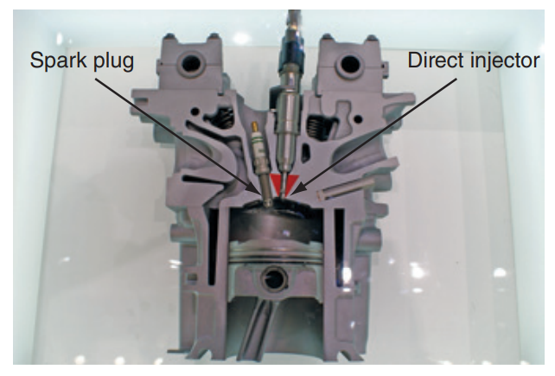
Injectors
With gasoline direct injection, specially designed injectors deliver the fuel into the high pressures and temperatures in the cylinders.
To prevent the heat from igniting the fuel in the injector, the injectors are designed to completely seal after the fuel is sprayed.
The injectors must also be able to spray the fuel at a much higher pressure than what is in the cylinder.
If this did not happen, the fuel would not enter the cylinder; instead, the cylinder’s pressure would enter the injector.

Slide 26
Knowledge Check (2 of 2)
Gasoline Direct-Injection is drastically different than previous EFI systems because the tips of the injectors are located in the _____ _____?

Slide 27
Knowledge Check Answer (2 of 2)
Gasoline Direct-Injection is drastically different than previous EFI systems because the tips of the injectors are located in the combustion chamber.

Slide 28
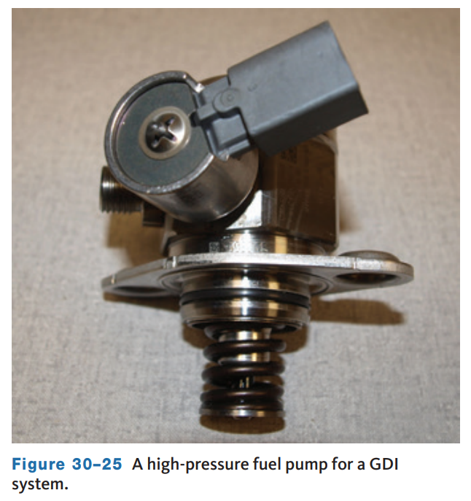
High-Pressure Fuel Pump
Gasoline is moved from the fuel tank to the engine in a conventional way, which is by an in-tank electric pump.
The fuel is delivered to a mechanical, high-pressure pump driven by an eccentric on the end of a camshaft.
This pump supplies fuel to a variable-pressure fuel rail.
The individual injectors are attached to the rail.
The pump is a volume-controlled, high-pressure pump.
It only moves the required amount of fuel to the injectors.

Slide 29
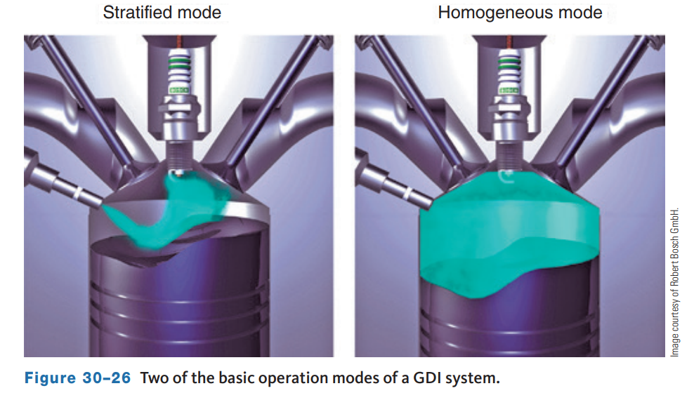
Operational Modes
Most direct-injection systems can operate in three distinct modes: lean burn, stoichiometric, and full power.
Each of these modes has different air–fuel ratios, injection timing, and pump pressures.
The PCM chooses the mode based on operating conditions.
The lean mode relies on a stratified charge for combustion, and the stoichiometric and full-power modes rely on a homogeneous mixture, which means that the air and fuel are well mixed.
The systems also have a limp-home mode if the PCM detects a problem with the system.

Slide 30
Compression Ratios
The ability of a direct injection to change air–fuel ratios and injection timing over a wide range also allows it to eliminate most conditions that would cause engine knock.
This means GDI engines can operate at higher compression ratios without requiring the use of high-octane gasoline.
The benefit of high compression is simply higher compression extracts more energy from each droplet of fuel.
Therefore, running higher compression ratios provides increased engine horsepower and torque without consuming more fuel.
Higher compression ratios are also possible because the small droplets of fuel injected directly into the cylinder tend to cool the mixture in the cylinder.
This cooling makes the mixture denser, means more power can be produced, and makes the mixture less likely to detonate.

Slide 31
Advantages of GDI
When compared to other injection systems, direct injection has the following advantages:
  Increases fuel efficiency
  Provides higher power output
  Increases the engine’s volumetric efficiency
  Lowers engine thermal losses
  Decreases emissions (NOx may increase if combustion temperatures go too high.)
  Allows the engine to have high compression without the need to use high-octane fuel
  Reduces most of the turbo lag when used with a turbocharger

Slide 32
Disadvantages of GDI
Several disadvantages of GDI systems are carbon build up on the intake valves and injectors and repair costs.
With traditional PFI systems, fuel from the injectors helps to keep the backside of the intake valves clean from carbon build up.
Because fuel does not flow past the intake valves on GDI systems, carbon begins to build up, which can lead to driveability concerns such as:
  Loss of power under acceleration and higher speeds
  Cold engine stalling
  Misfires and rough running
  Reduced fuel economy
When work needs to be performed on the high-pressure system, the steel lines that connect the injectors and pump to the fuel rail must be replaced when removed.
The fittings are designed for onetime use, and leaks can occur if reused.

Slide 33
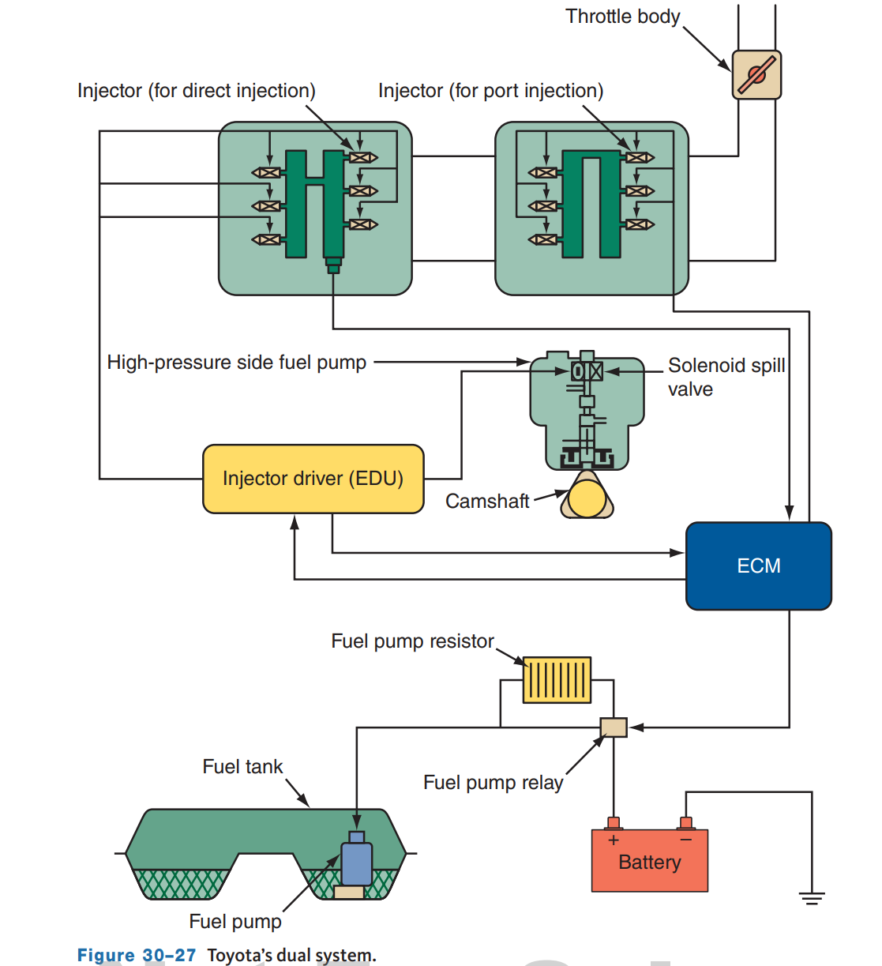
GDI Plus SFI
Some engines use a combination of direct and indirect injection. Each cylinder has two injectors: one at the intake port and the other directly in the cylinder.
Both sets of injectors work in the same way as they would in a normal setup.
However, the PCM shuts down the port injection when it is not needed.
When the engine is cold or running at low to middle speeds with a light load, both injection systems operate.
During high engine speeds and heavy loads, only direct injection is used.
During cold starts, the port and direct injectors work together to create a lean stratified.

Slide 34
Discussion
You have learned much about GDI systems.
Have a class discussion about the advantages and disadvantages, and how GDI plus SFI has helped.

Slide 35
Chapter Reflection
Please take a moment to consider your understanding of EFI systems after this chapter. Then respond to the following questions in one or two paragraphs. Use 150–200 words in your reflection.
Were there any concepts about EFI that you found difficult to understand? What will you do to ensure you understand them?
Considering all you have learned about EFI, do you feel prepared to perform diagnosis and service in a shop or lab setting? What will you do to be better prepared?

